Slide 1

Statistical Computation Methods for Data Science Unit-V
By
S.U.RAVI KUMAR CHAVALI
Assistant professor of Mathematics
Department of Science and Humanities
Sreenidhi Institute of Science and Technology
Yamnampet, Ghatkesar.
1
Notes:
1

Slide 2
We discuss the following in today’s Lecture
What is a time series data?
What kinds of variation are in a time series data?
How to analyze a time series data?

Slide 3
Regression Analysis
Vs
Time Series Analysis (TSA)

Slide 4
Quantitative Forecasting Methods
Quantitative
Forecasting
Time Series
Causal
Models
Models
Moving
Exponential
Trend
Regression
Average
Smoothing
Models
Notes:
15

Slide 5
An arrangement of statistical data in accordance with time of occurrence or in a chronological order is called a time series.
The numerical data which we get at different points of time-the set of observations is known as time series.
In time series analysis, current data in a series may be compared with past data in the same series.
We may also compare the development of two or more series over time.
What is a time series data?

Slide 6
What is a time series data?
Example:
For example, if we observe agricultural production, sales, National Income etc., over a period of time, say over the last 3 or 5 years, the set of observations is called time series.
Thus a time series is a set of time, quantitative readings of some various recorded at equal intervals of time.
The interval may be an hour, a day, a week, a month, or a calendar year.

Slide 7
Uses of Time Series
The analysis of time series is of great significance not only to the economists and business man but also to the scientists, astronomists, geologists, sociologists, biologists, research worker etc. In the view of following reasons
It helps in understanding past behavior.
It helps in planning future operations.
It helps in evaluating current accomplishments.
It facilitates comparison.

Slide 8
Time Series Components
Trend
Cyclical
Seasonal
Irregular
Notes:
21

Slide 9
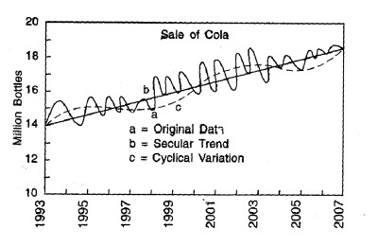
COMPONENTS OF A TIME SERIES
The values of a time series may be affected by the number of movements or fluctuations, which are its characteristics. The types of movements characterizing a time series are called components of time series or elements of a time series.
Secular trend (T)
Seasonal variation (S)
Cyclical variation (C)
Irregular variation (I)

Slide 10
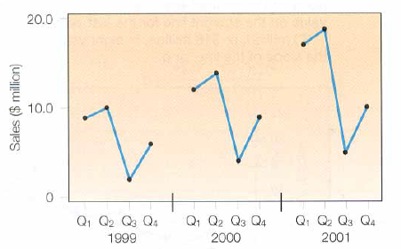
Seasonal Variations patterns of change within a year
Example: The quarterly sales of Hercher Sporting Goods 1999-2001quarterly, Inc.

Slide 11
Cyclical Variations or Oscillatory Variation
This is a short term variation occurs for a period of more than one year.
One of the best examples for cyclical variations is “Business Cycle”. In this cycle there are four well defined periods or phases.
(i) Boom, (ii) Decline (iii) Depression (iv) Improvement

Slide 12
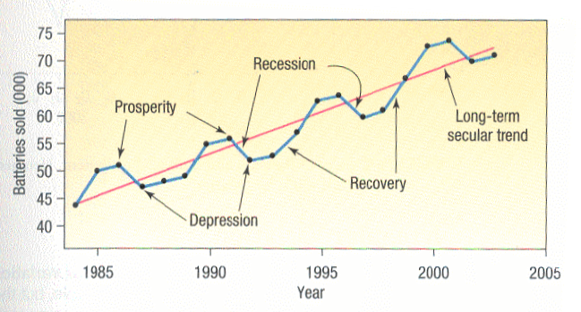
Cyclical Variations or Oscillatory Variation

Slide 13
Irregular Variation
It is also called Erratic, Accidental or Random Variations.
The three variations trend, seasonal and cyclical variations are called as regular variations, but almost all the time series including the regular variation contain another variation called as random variation.
This type of fluctuations occurs in random way or irregular ways which are unpredictable and due to some irregular circumstances which are beyond the control of human being such as earth quakes, wars, floods, lockouts, etc.
These factors affect the time series in the irregular ways.
These irregular variations are not so significant like other fluctuations.

Slide 14
Mathematical Model
In classical analysis, it is assumed that some type of relationship exists among the four components of time series. Analysis of time series requires decomposition of a series, to decompose a series we must assume that some type of relationship exists among the four components contained in it.
The value Y_{t} of a time series at any time t can be expressed as the combinations of factors that can be attributed to the various components. These combinations are called as models and these are two types.
(i) Additive model (ii) Multiplicative model

Slide 15
Additive model
In additive model Y = T_{t} + S_{t} + C_{t} + R_{t}
Where T_{t} = Trend value at time t
S_{t} = Seasonal component t
C_{t} = Cyclical component t
R_{t} = Irregular component t
But if the data is in the yearly form then seasonal variation does not exist, so in that situation Y = T_{t} + C_{t} + R_{t}
Generally the cyclical fluctuations have positive or negative value according to whether it is in above or below the normal phase of cycle.

Slide 16
Multiplicative model
In multiplicative model Y = T_{t} .S_{t} .C_{t} .R_{t} .
The multiplicative model can be put in additive model by taking log both sides. However most business analysis uses the multiplicative model and finds it more appropriate to analyze business situations.

Slide 17
Recapitulation:
What is a time series data?
What kinds of variation are in a time series data?
How to analyze a time series data?

Slide 18
THANK YOU
Notes:
18

